Slide 1

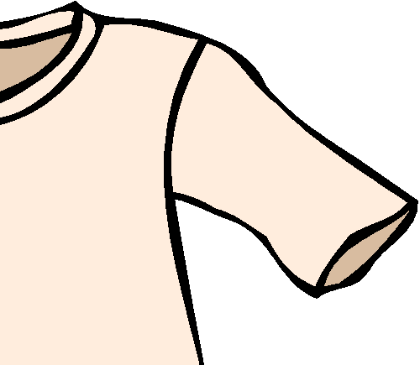
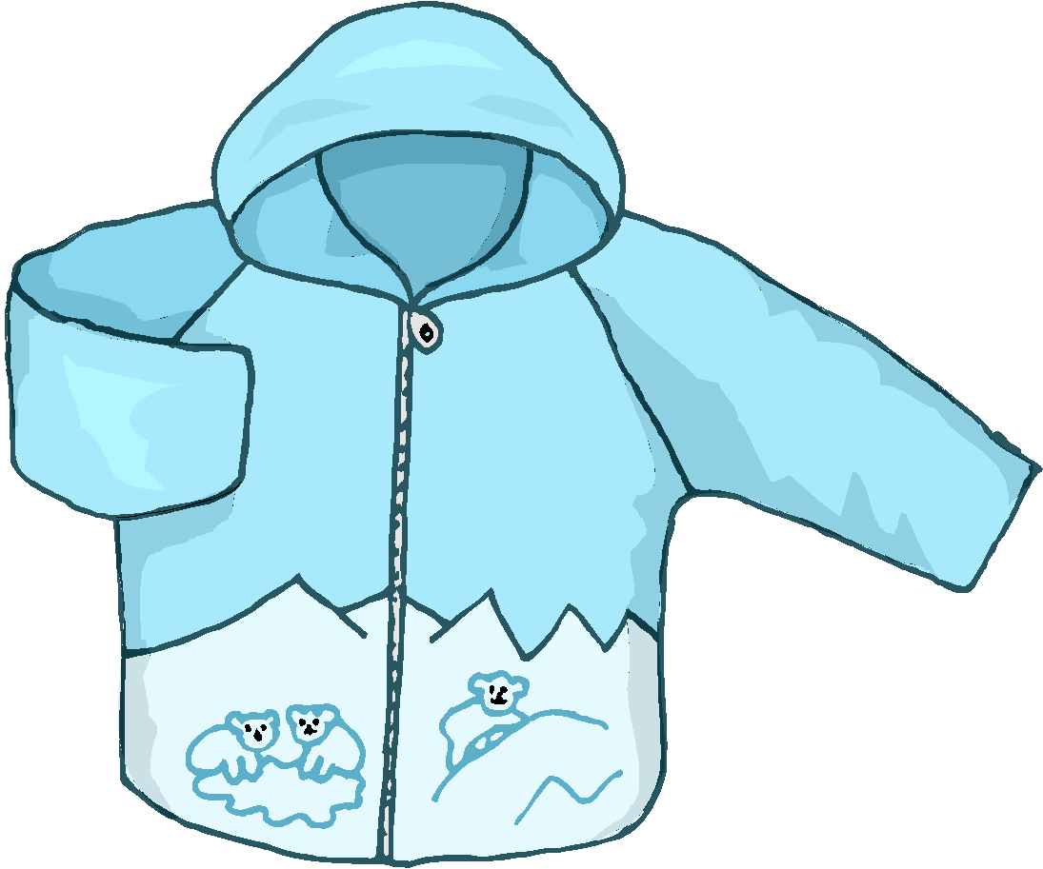



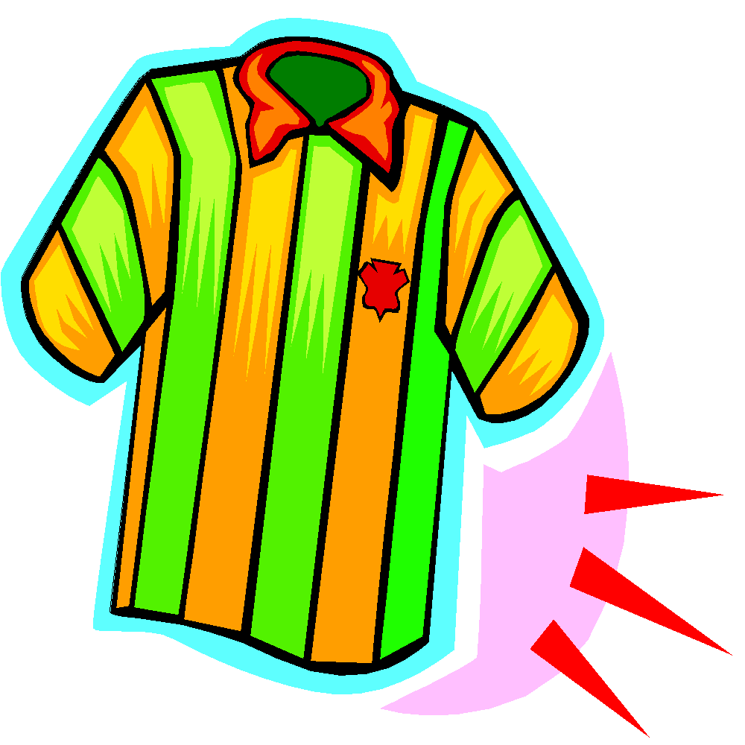
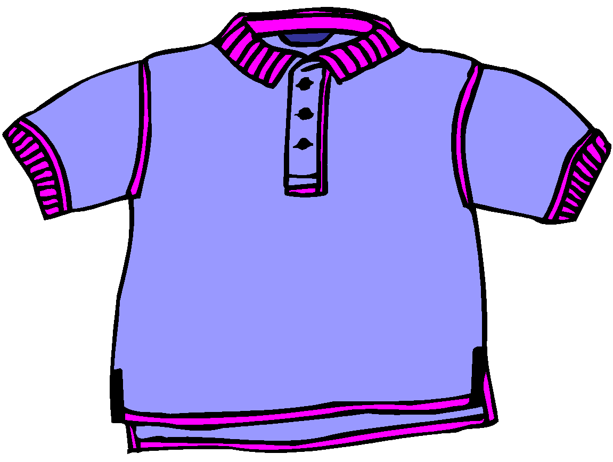








= short sleeve
= long sleeve
Lost & Found
button =
stripes =
plain =
1
2
Hello. How
can I help you?
Hi. I lost my T-shirt.
Has anyone found it?
3
4
What does
it look like?
It has short sleeves and three buttons.
5
6
Does it have stripes?
No, it doesn’t. It is plain.
7
8
I’m sorry. No one has
found it yet. Try again later.
Ok. Thanks.

Slide 2
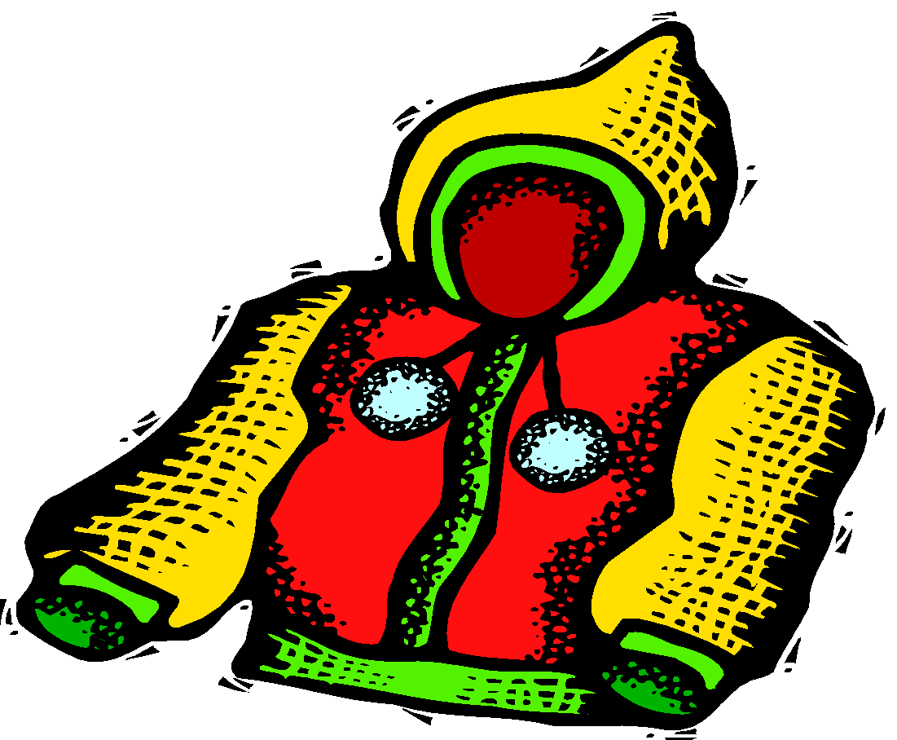


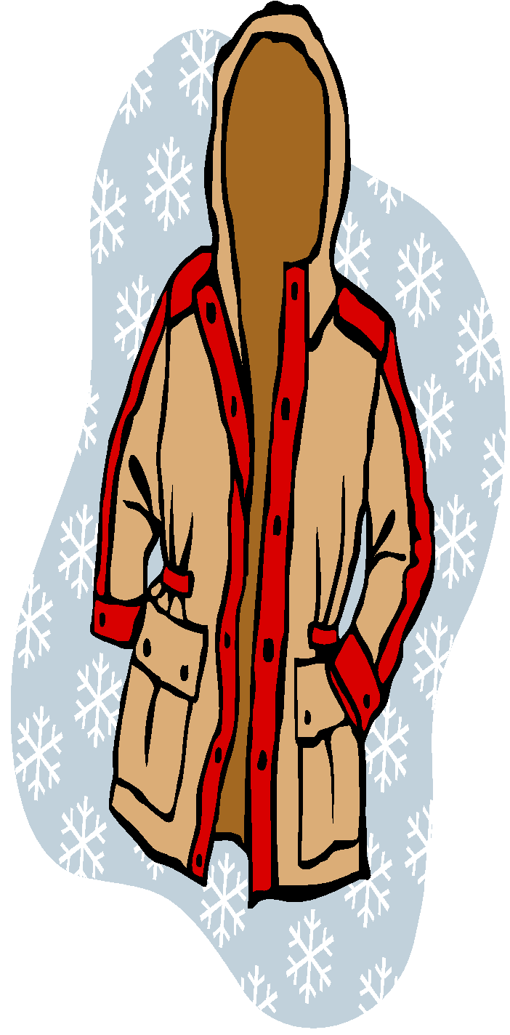





pocket =
hood =
Lost & Found
polka dots =
zipper =
2
Hello. How
can I help you?
Hi. I lost my jacket.
Has anyone found it?
4
What does
it look like?
It has two pockets
and a hood.
6
Is it plain with buttons?
No, it isn’t. It has white
polka dots and a zipper.
I’m sorry. No one has
found it yet. Try again later.
8
Ok. Thanks.

Slide 3
NOW WORK IN PAIRS.
CHOOSE ONE OF THE OBJECTS IN THE FOLLOWING SIDES. YOUR PARTNER HAS TO GUESS WHICH IS IT. THEN CHANGE TURNS.
USE THE FUNCTIONAL LANGUAGE/ EXPRESSIONS IN THE FOLLOWING SLIDE TO HELP YOU:

Slide 4
FUNCTIONAL LANGUAGE
GOOD MORNING, CAN I HELP YOU?
I LOST MY ………………. YESTERDAY/LAST WEEK
I LEFT IT ON ……….
WHAT DOES IT LOOK LIKE?
IT’S …………….
WHAT IS IT MADE OF ?
IT’S MADE OF ……….
DOES IT HAVE A PATTERN?
YES, IT’S ……………../ NO, IT DOESN’T
WHAT COLOUR IS IT?
…………….
IS IT ANY OF THESE? /IS IT THIS ONE?

Slide 5
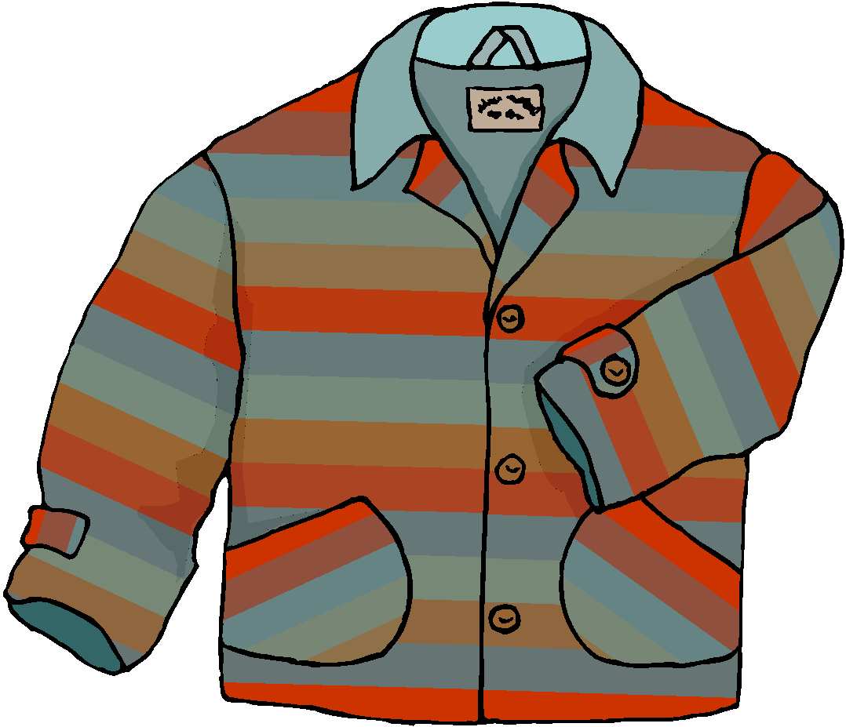

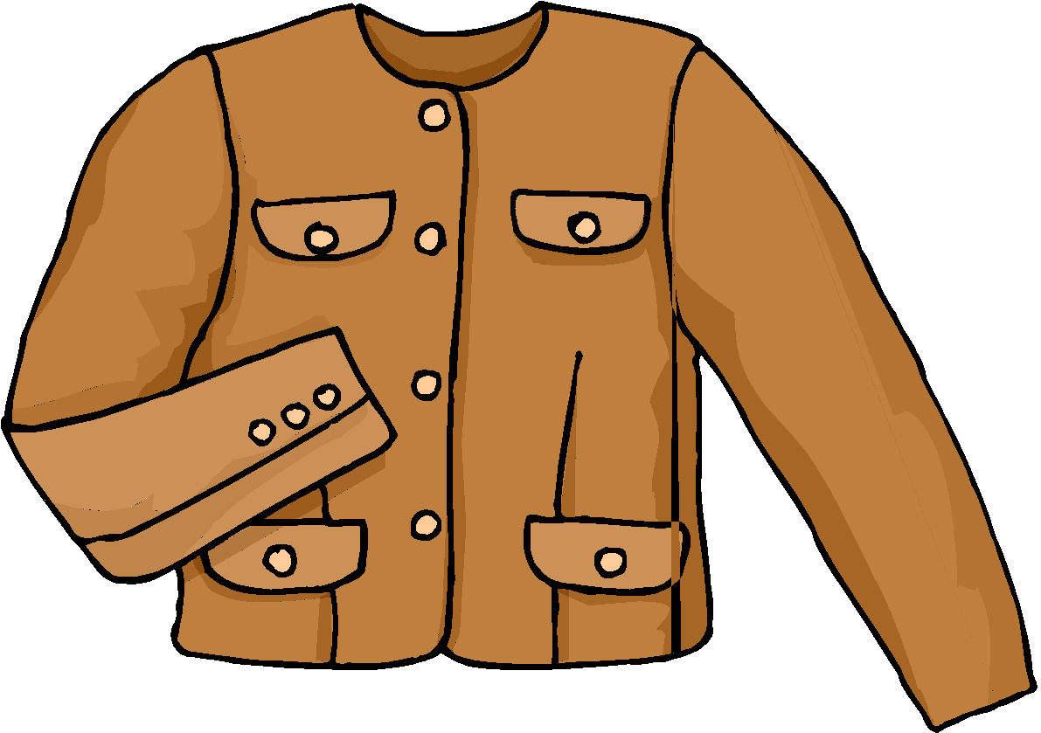

Slide 6





Slide 7


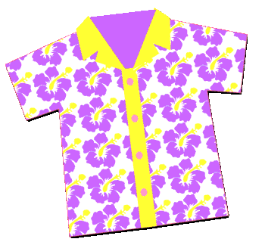
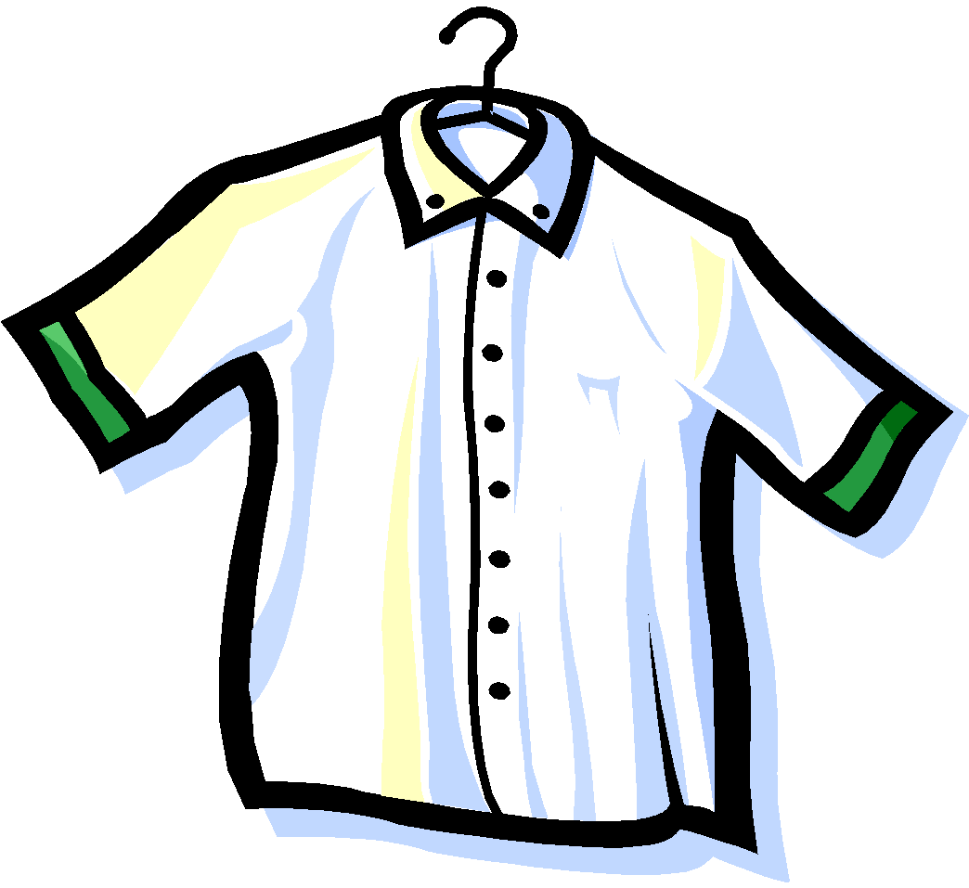

Slide 8

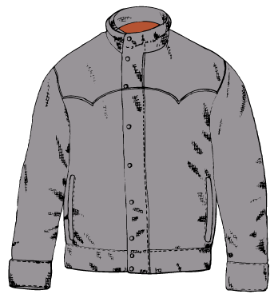


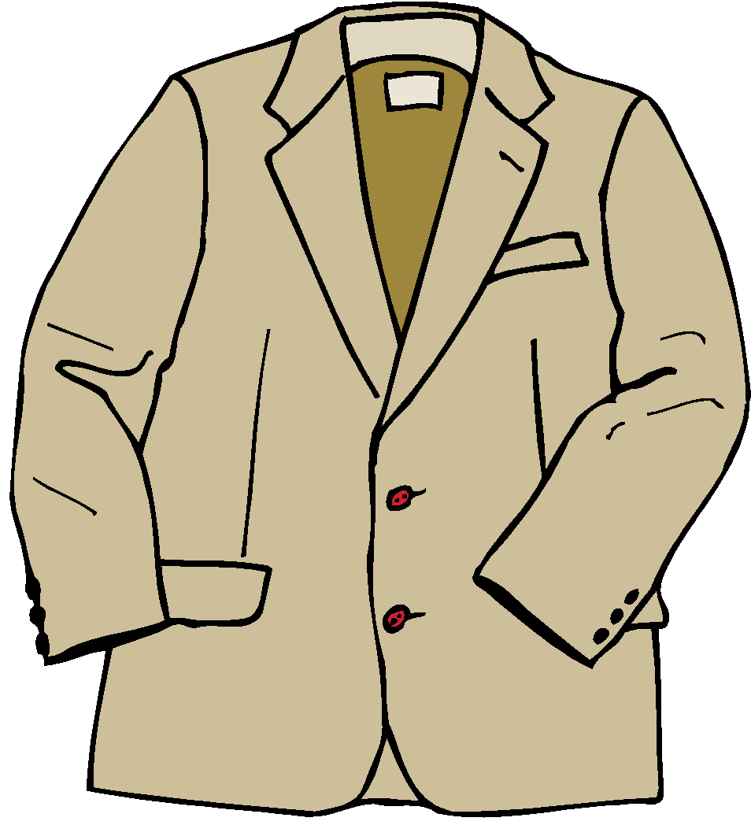
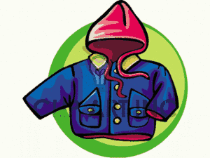

Slide 9




Slide 10
lost
found
found
lost
found
lost
found
lost

