Slide 1
CHEF PERSONALITY
ADJECTIVES

Slide 2
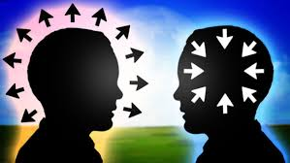
Open-minded: if you describe someone as open-minded, you approve of them because they are willing to listen to and consider other people’s ideas and suggestions.

Slide 3

Leadership: leadership refers to the qualities that make someone a good leader, or the methods a leader uses to do his or her job.

Slide 4
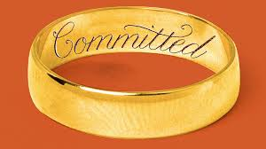
Committed: a committed person is a person who takes a commitment with a person, a business or a policy.

Slide 5
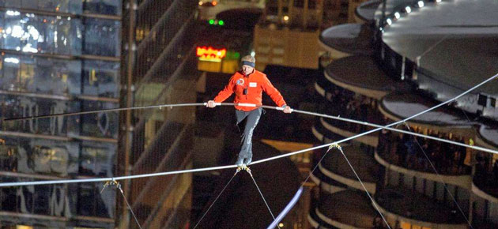
Cool-headed: refers to people who stay calm in difficult situations.

Slide 6
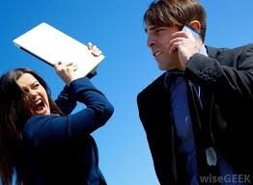
Hot-headed: refers to someone who acts too quickly without thinking on the consequences.

Slide 7
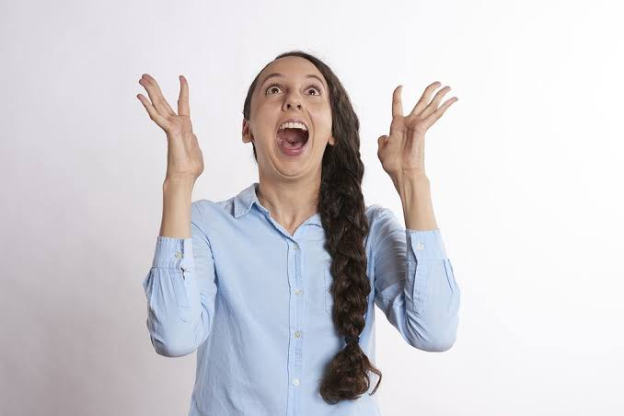
Enthusiastic: If you are enthusiastic about something, you show how much you like or enjoy it by the way that you behave and talk.

Slide 8

Organised: Someone who is organized plans their work and activities efficiently.

Slide 9
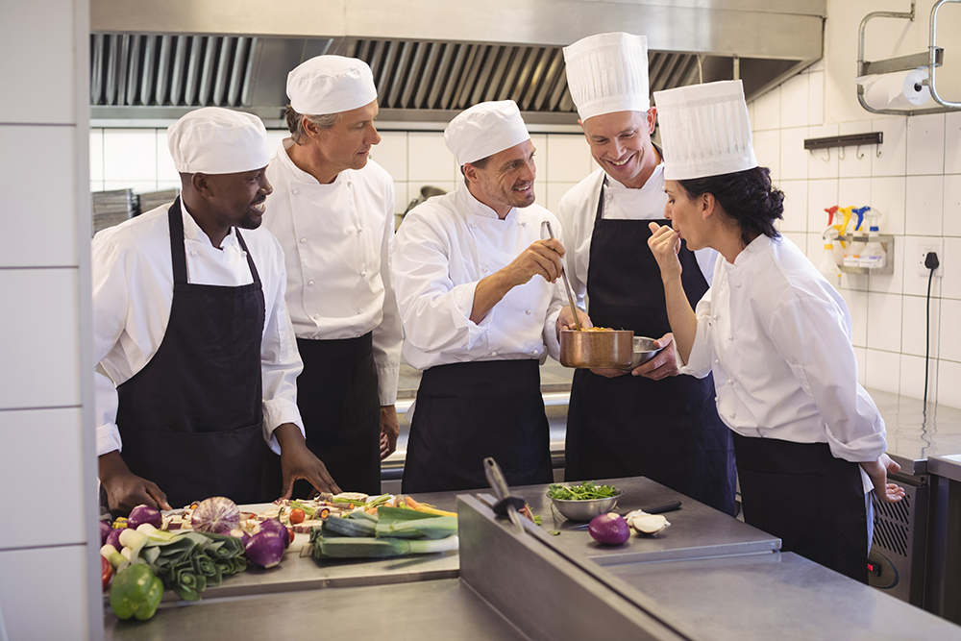
Communicative: Someone who is communicative talks to people, for example about their feelings, and tells people things.

Slide 10
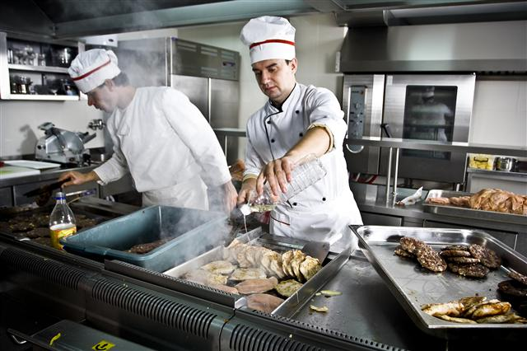
Hard-working: If you describe someone as hard-working, you mean that they work very hard.

