Slide 1
GRAMMAR
TELLING THE TIME
AND
PREPOSITIONS OF TIME

Slide 2
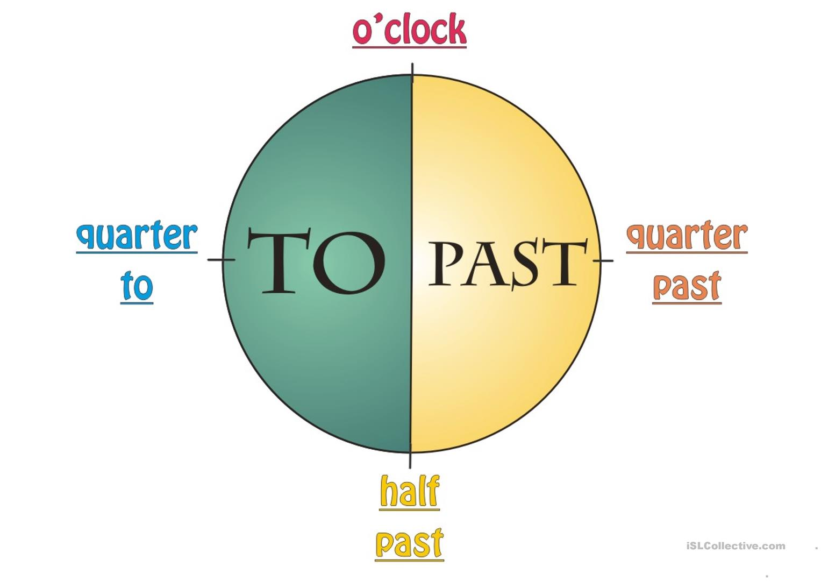
TELLING THE TIME

Slide 3
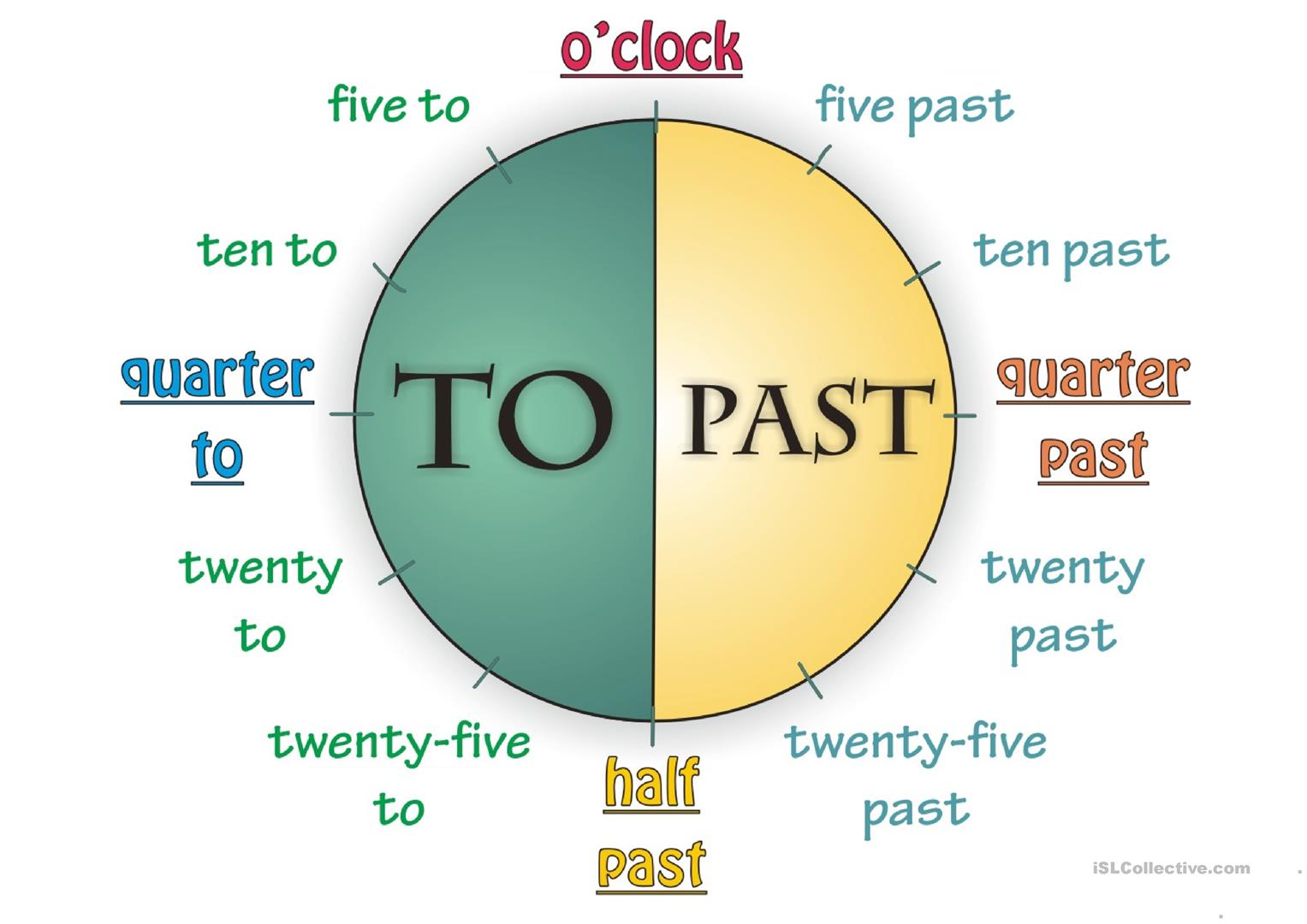
TELLING THE TIME

Slide 4
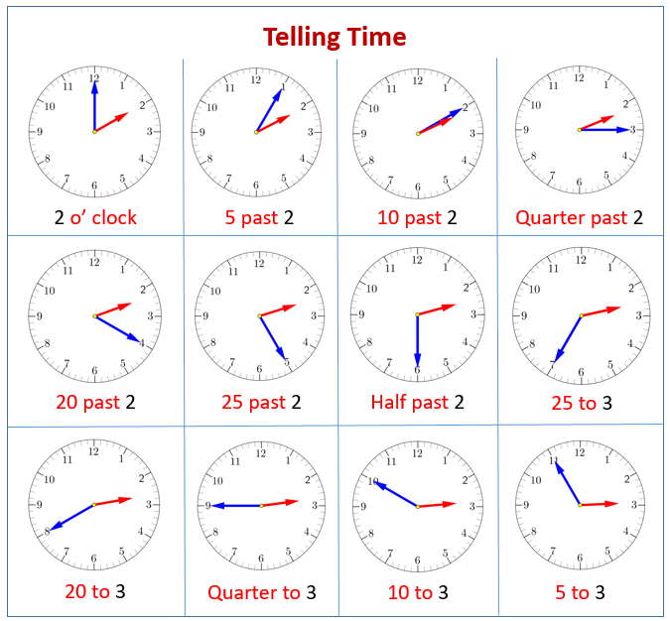
EXAMPLES
Watch this video, review and write the times at the end of the clip.
https://www.youtube.com/watch?v=3icBxO6Wjz

Slide 5
PREPOSITIONS OF TIME
IN, AT and ON.
We use AT:
For precise times
We use IN:
For months In May
Years In 1990
Centuries In the next century
Long periods In the past
We use ON:
For dates and days
At 3 o’clock
At 10.30
At dinnertime
On Thursday
On 6 March
On my birthday
On Christmas Day

Slide 6

PREPOSITIONS OF TIME
IN, AT and ON.
WE USE
AT in the following expressions:
At night
At the weekend
At the same time
At Christmas
At present
IN/ON
In the morning On Wednesday morning
In the afternoon On Sunday afternoon
In the evening On Monday evening

